Slide 1
Brief Introduction to Data Visualization and Best Practices
Richard Johansen
And
Bill McMillin

Slide 2
Visual (Data) Literacy
“Visual literacy skills equip a learner to understand and analyze the contextual, cultural, ethical, aesthetic, intellectual, and technical components involved in the production and use of visual materials. A visually literate individual is both a critical consumer of visual media and a competent contributor to a body of shared knowledge and culture.”
ACRL Visual Literacy Competency Standards for Higher Education
Notes:
Would anyone like to read this definition of visual literacy? Ask for a volunteer to read

Slide 3
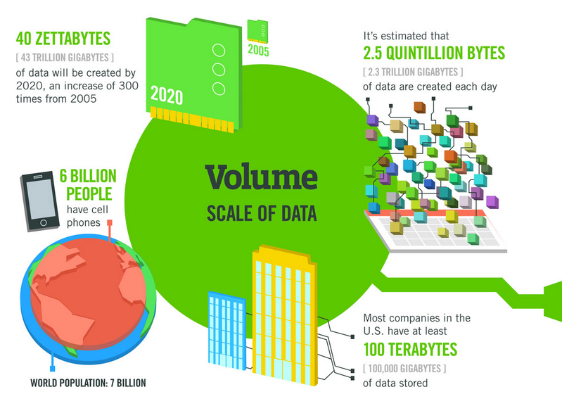

Data Doesn’t Sleep
A Minute on the Internet
16M texts
156M emails
900K FB logins
1.8M Snaps
450K Tweets
3.5M Google Searches
1M tinder Swipes
70K Hours of Netflix
$751,000 Spent Online
http://www.visualcapitalist.com/happens-internet-minute-2017/

Slide 4
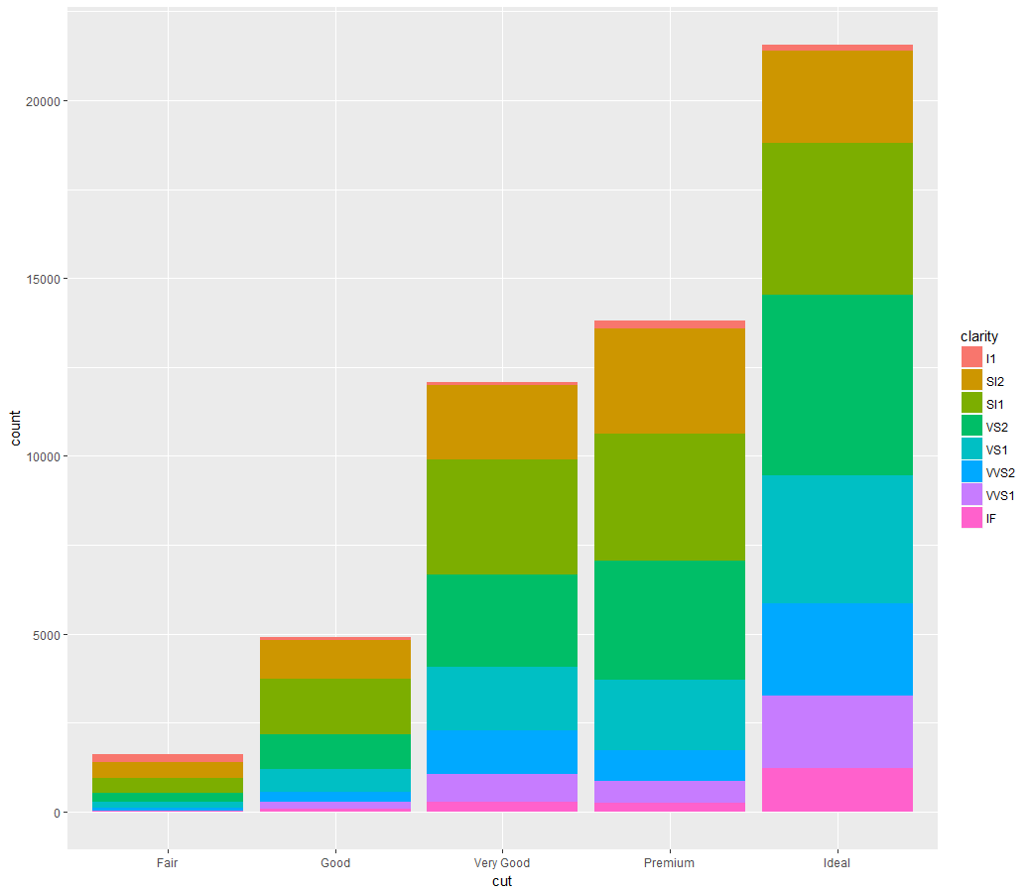
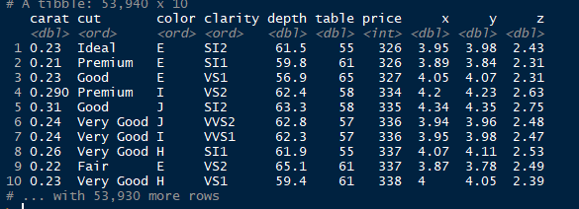
What is Data/Scientific Visualization
“Visualization transforms data into images that effectively and accurately represent information about the data.” –Schroeder et al. The Visualization Toolkit, 2nded. 1998
A picture is worth a 1,000 words (observations)

Slide 5
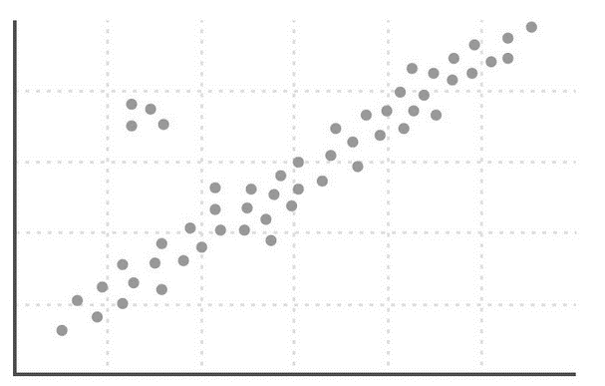
Why Do Visualization
Three main modes of data visualization
Exploration
Use visualizations as a means of data exploration
Analysis
Verify (or Falsify) a hypothesis
Presentation
Visualization is used to communicate results or findings

Slide 6
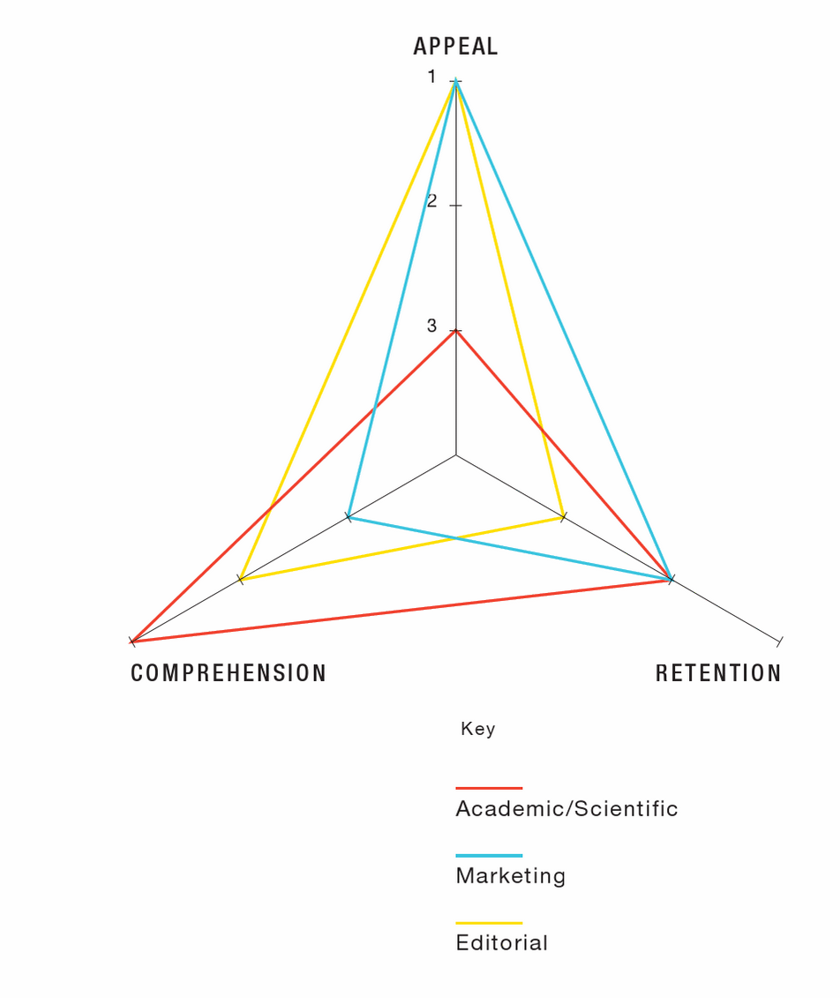
Important Considerations
Who is the audience?
What is the purpose or goal?
What is the story?
What are the standards or conventions?
Infographics : The Power of Visual Storytelling by Lankow, Jason, Crooks, Ross, Ritchie, Josh
Notes:
Hannah - before and throughout the process, it is important to consider the audience, purpose/story, and any domain standards or conventions.

Slide 7
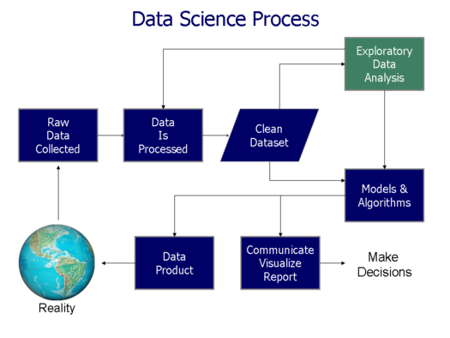
Data Science Process
Acquire Data
“Know your data”
Clean and Pre-Process
Visualize (explore)
Model/Analyze
Communicate Findings/ Data Production
Notes:
Jennifer

Slide 8
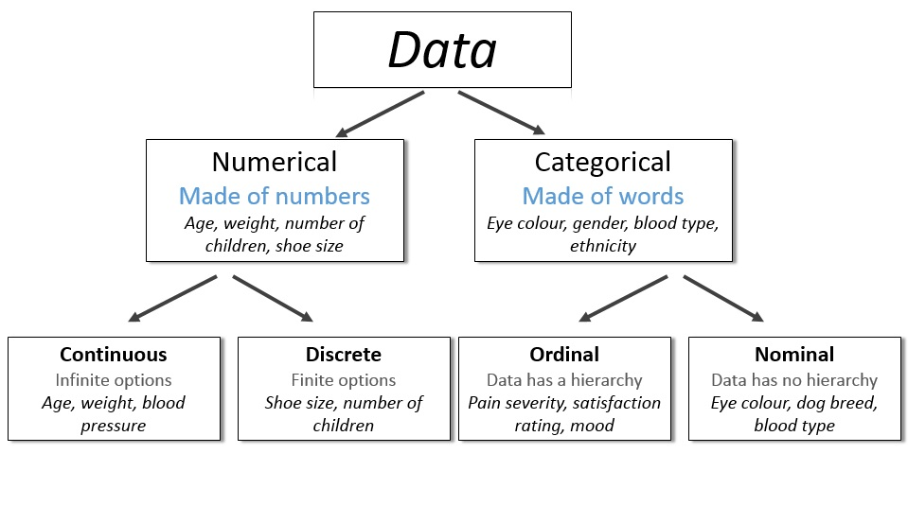
Know Your Data Type

Slide 9
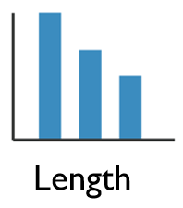
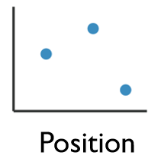
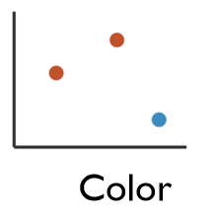
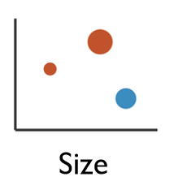
Graphing Visualizations
1 Dimensional Data
Length
2 Dimensional Data
Position
2+ Dimensional Data
Position
Color Hue/Saturation
Size
Shape

Slide 10
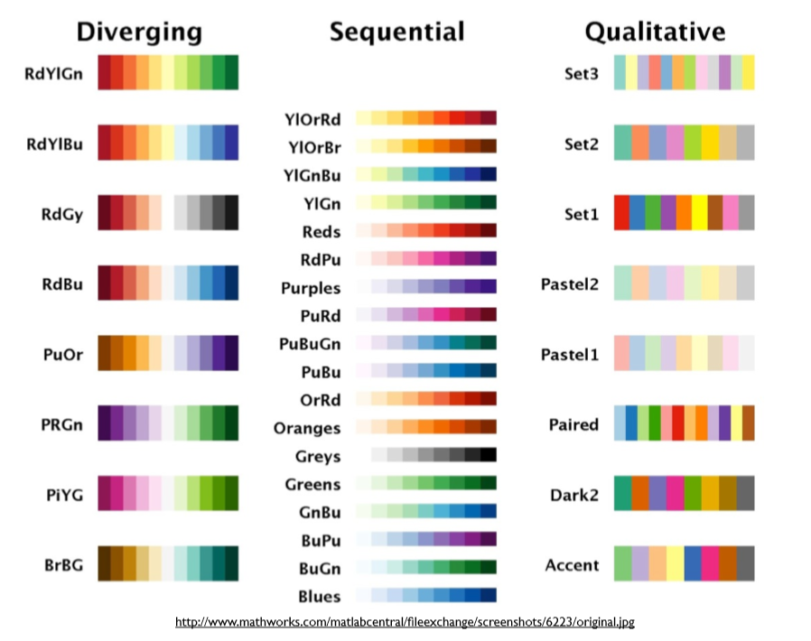
Color Schemes
Diverging: Emphasizes positive and negative change around a mid-point
Sequential: Used for showing logically arranged values from low to high
Qualitative: Uses hue to display nominal differences

Slide 11
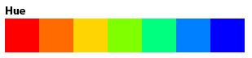
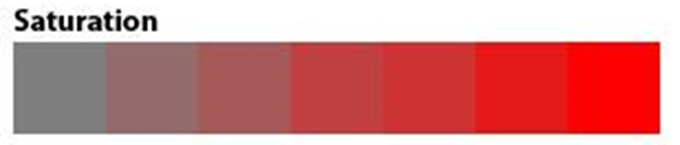
Color Best Practices
Use fewer than 6 colors
Use color opposites
Less Saturation = Smaller Value
More Saturation = Greater Value
Don’t Fight Established Norms
Water is blue, Vegetation is green
Negative values are red

Slide 12
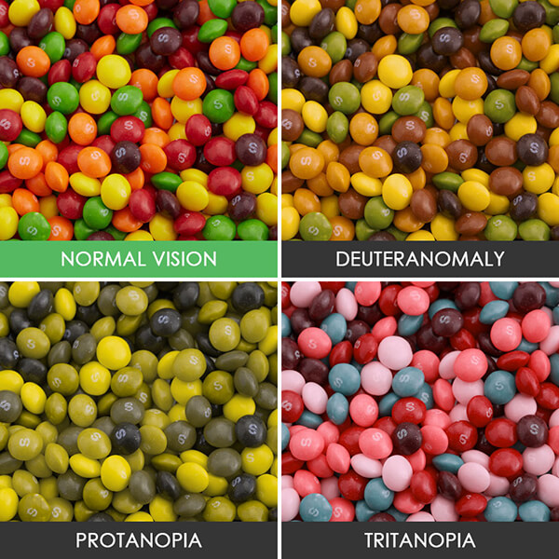
ADA Compliance
Red-Green
Deuteranomaly
Yellow and green appear redder
Difficult to tell violet from blue.
Most common affecting ~5% of males
Protanopia
Red appears as black.
Certain shades of orange, yellow, and green all appear as yellow.
Affects ~1% of males.
Blue-Yellow
Tritanopia
Blue appears green
Yellow appears violet or light grey
Extremely rare affecting males and females equally.

Slide 13
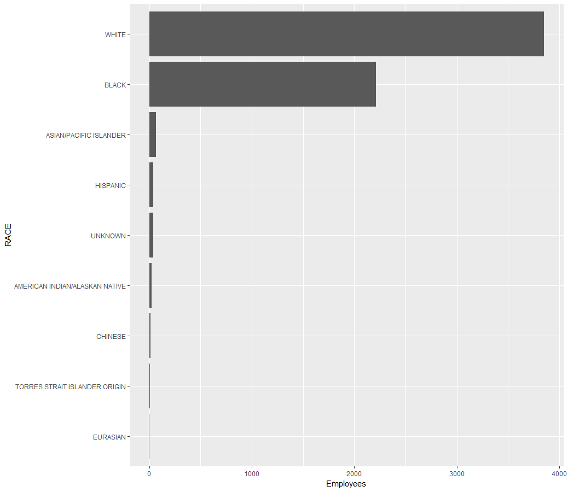
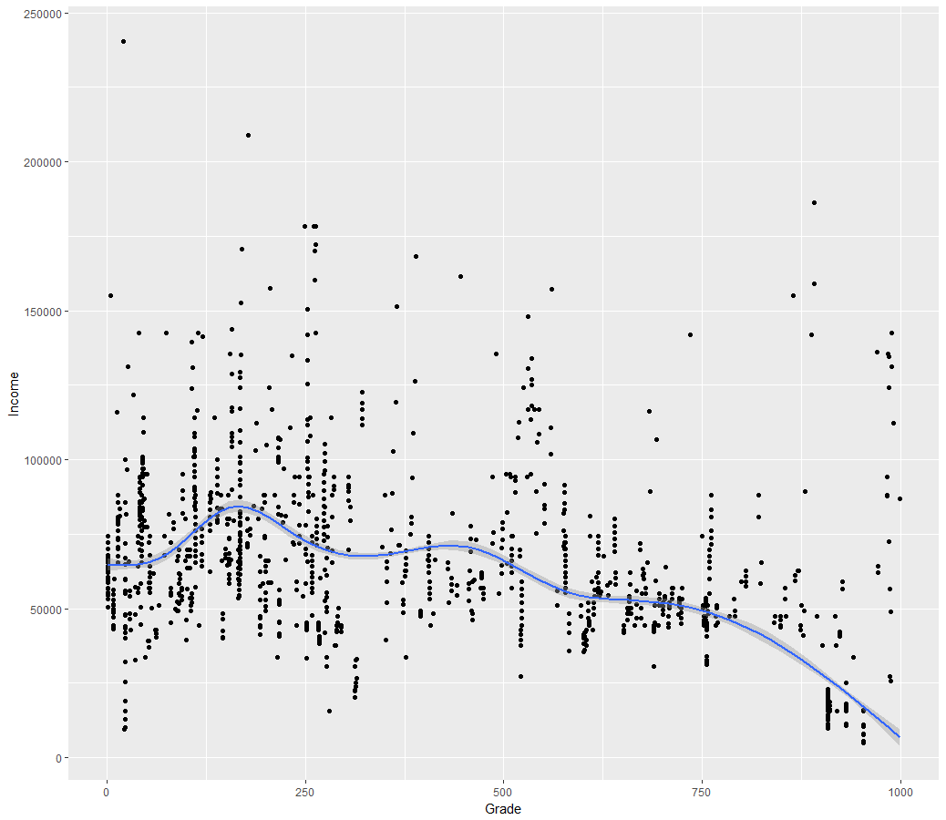
Plotting Data

Slide 14
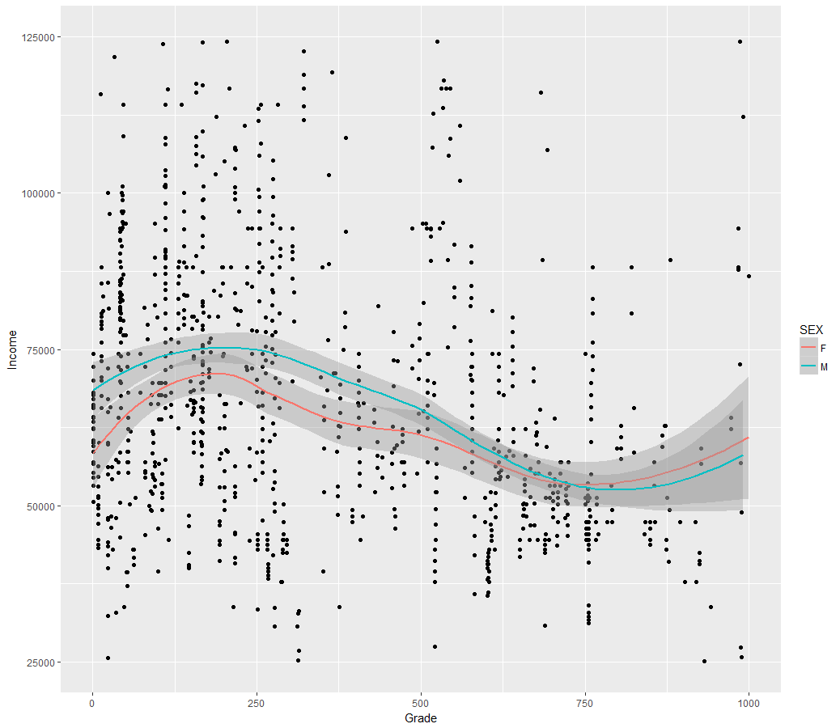
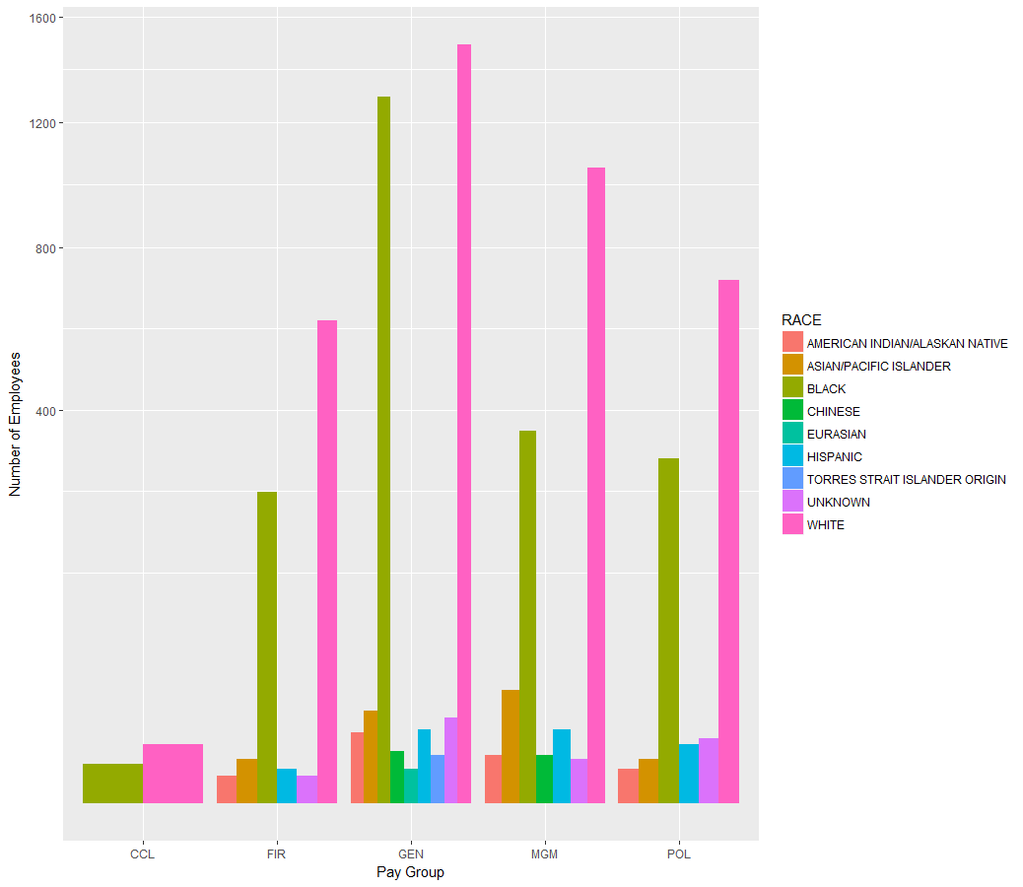
Plotting Grouped Data

Slide 15
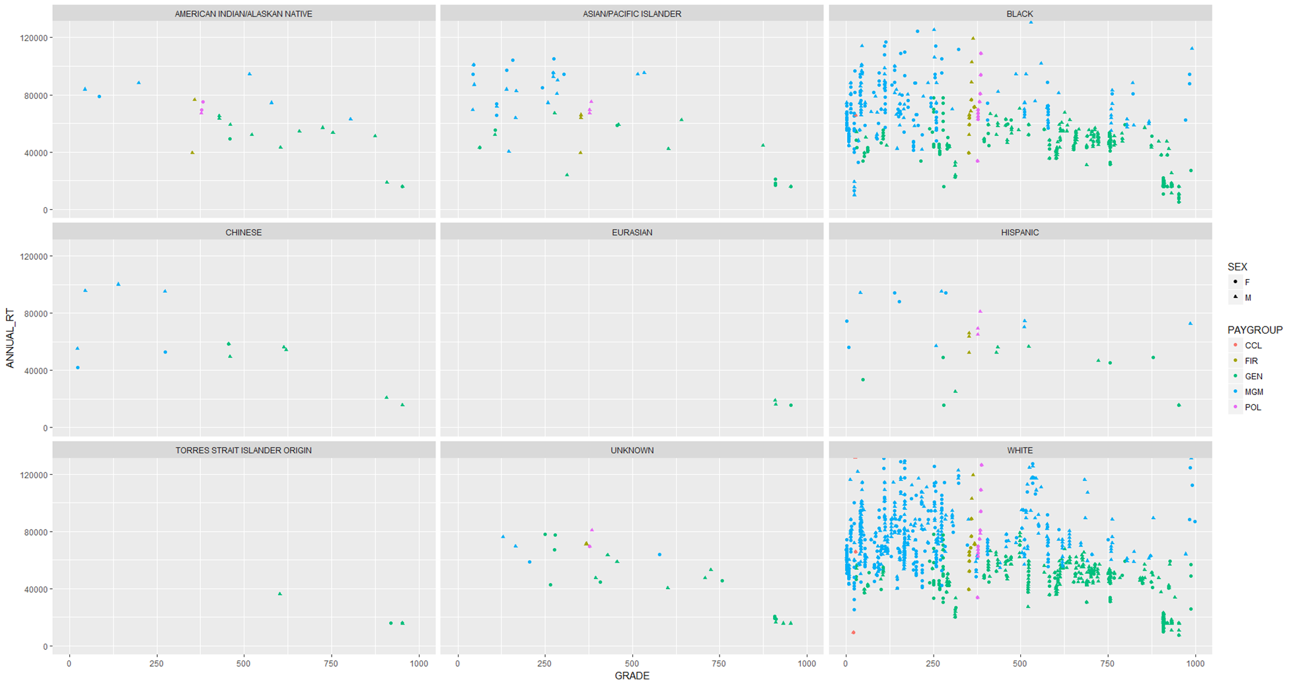
Using Visualizations to Explore Data

Slide 16
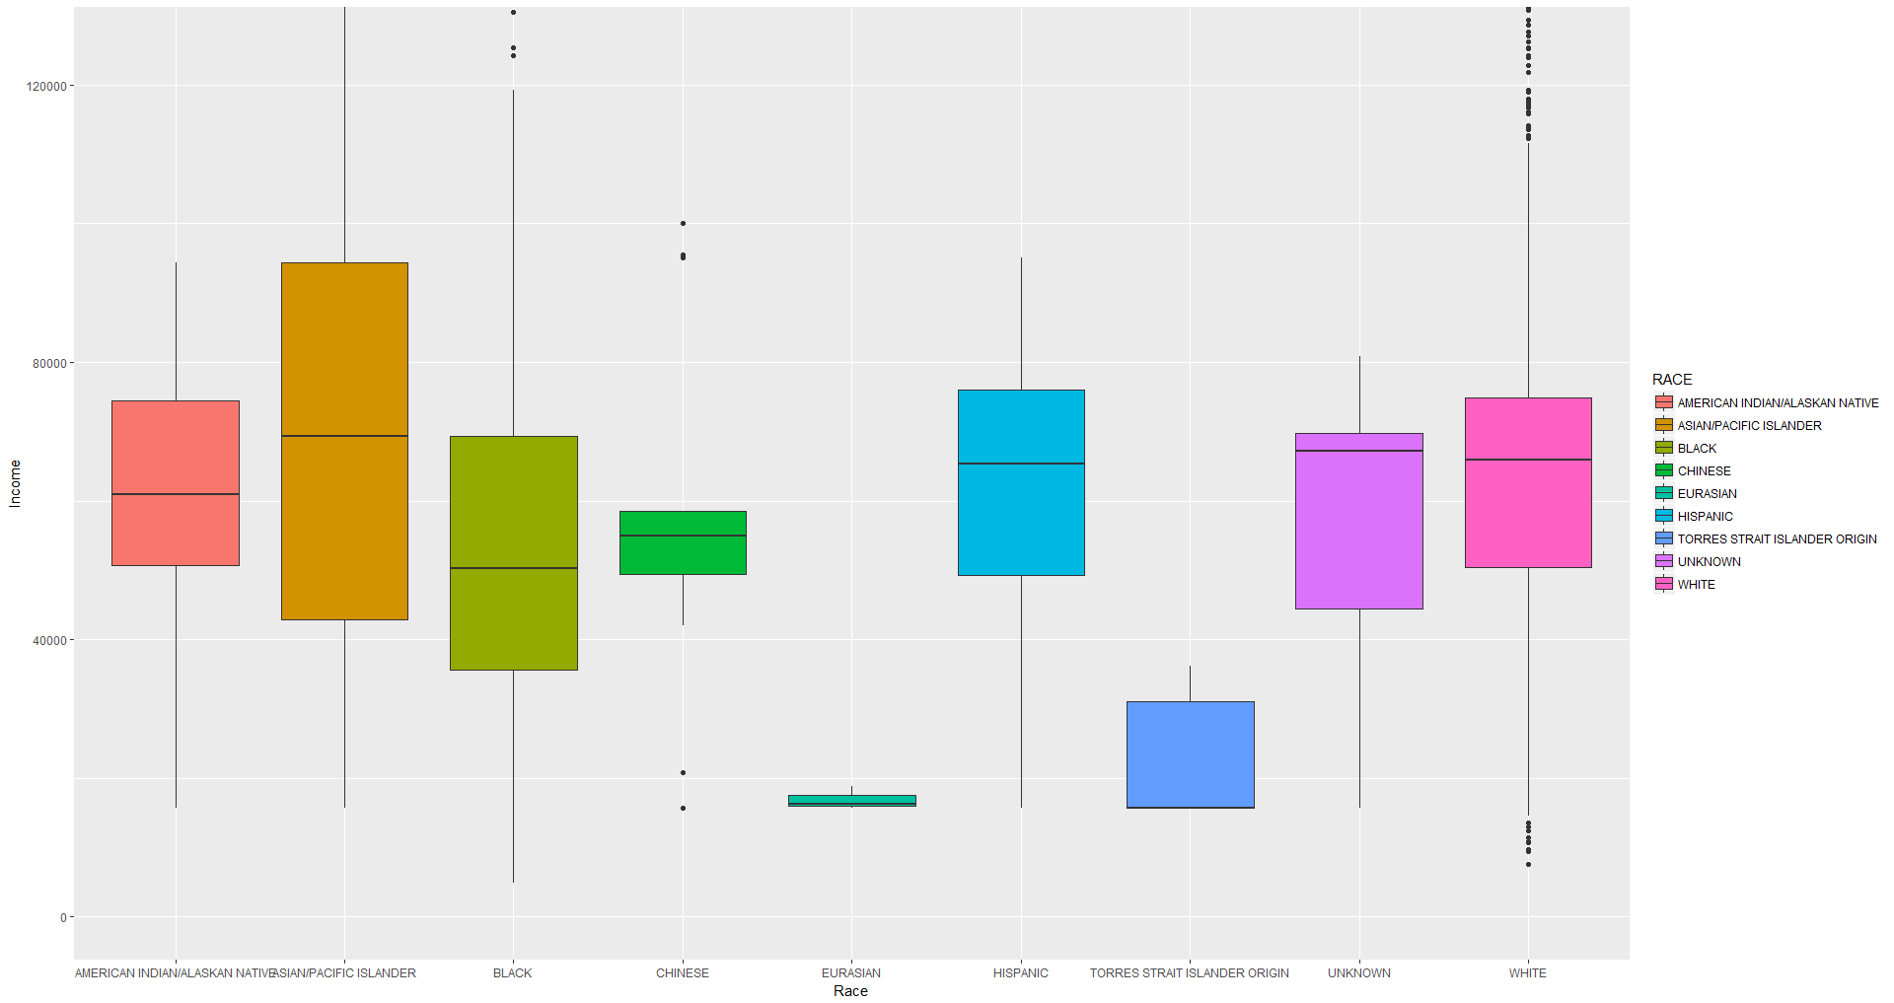
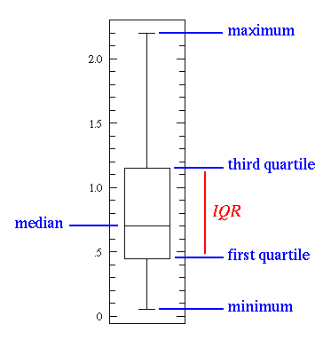
Visualizations and Statistics

Slide 17
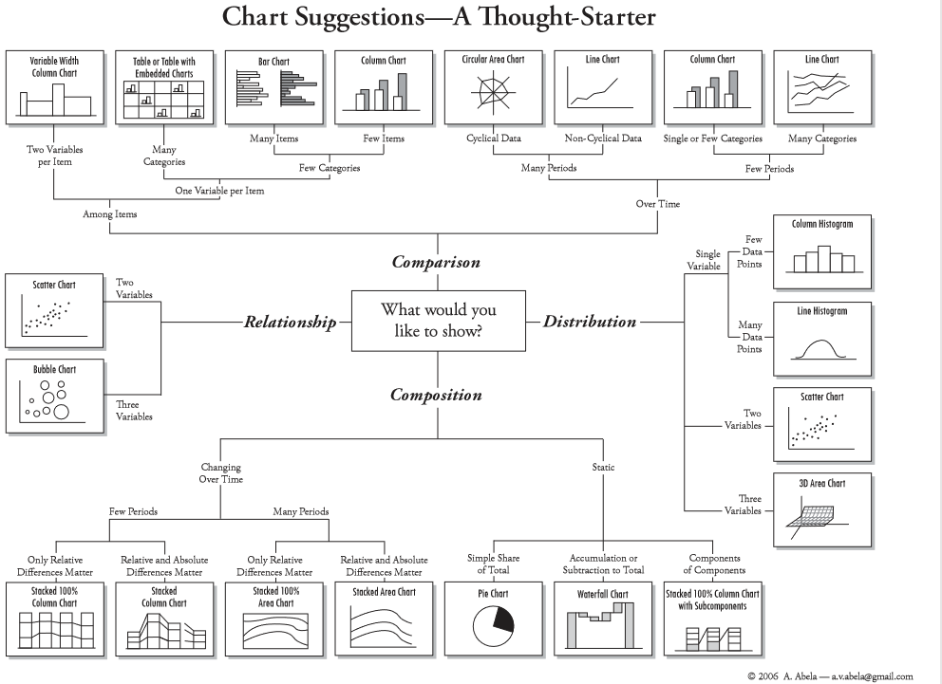

Slide 18
Grammar of Graphics
Originated by Leland Wilkinson, simplified by Hadley Wickham and others.
Data visualization is taking data and mapping it onto visual aesthetic, (points, lines, bars, etc).
Data
Geometry - visual encoding or symbol onto which the data is mapped. Each geom. has aesthetics (length, position, etc)
Grouping - subsets the data
Statistics - transforms or summarizes data
Mapping - maps the data onto the geometry
http://vita.had.co.nz/papers/layered-grammar.pdf
Notes:
Alison

